Slide 1


Exploring heterogeneity:
Causes, quantification and techniques
Joanna in ‘t Hout

Slide 2
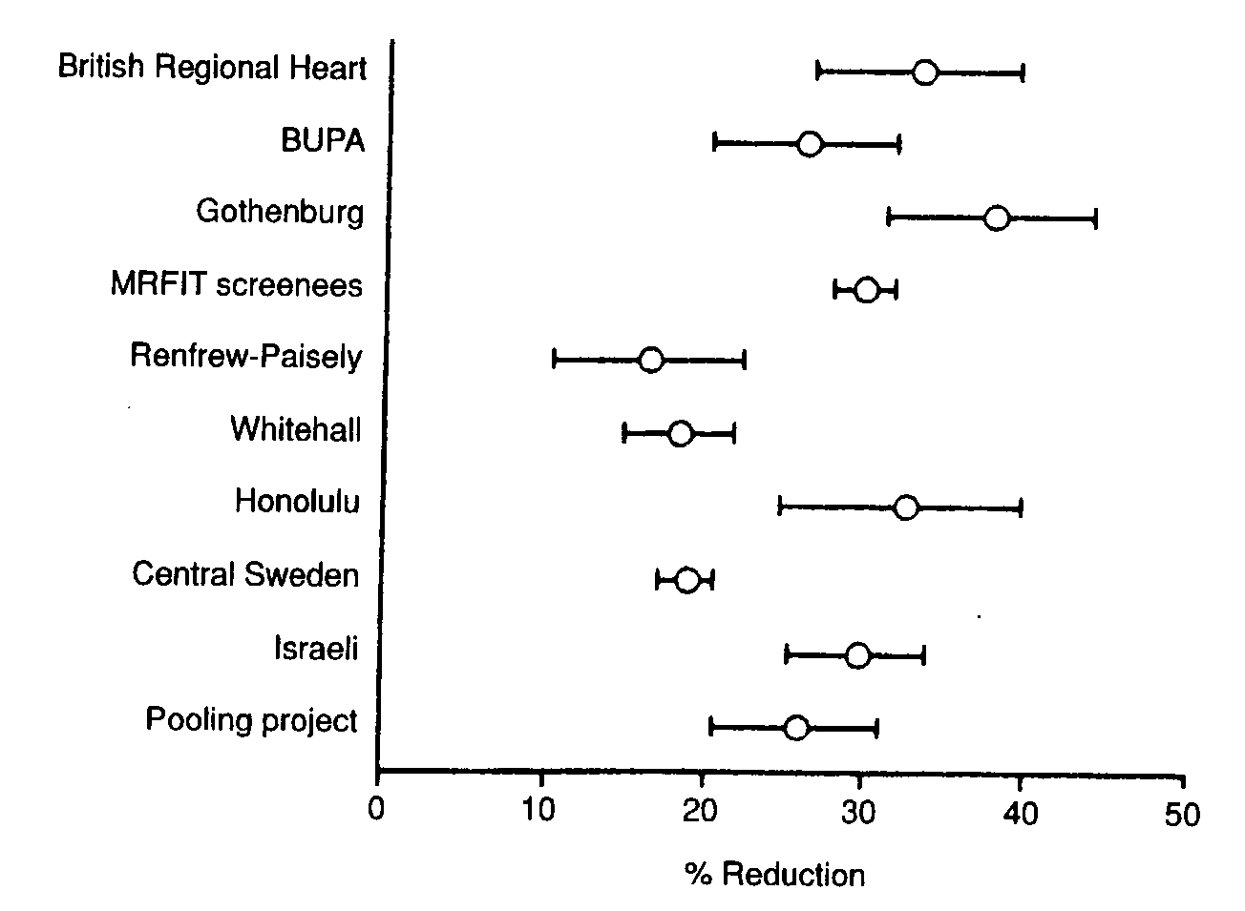
Cholesterol-lowering treatment vs. placebo on incidence of cardiovascular disease
% Reduction
Notes:
Investigate heterogeneity
Heterogeneity: variation across studies.
No two studies will be absolutely identical!
In dit geval quantitative heterogeneity: all studies show efficacy, but some show stronger effects than others
How Does High Cholesterol Cause Heart Disease?
When there is too much cholesterol in your blood, it builds up in the walls of your arteries, causing a process called atherosclerosis, a form of heart disease. The arteries become narrowed and blood flow to the heart muscle is slowed down or blocked. The blood carries oxygen to the heart, and if not enough blood and oxygen reach your heart, you may suffer chest pain. If the blood supply to a portion of the heart is completely cut off by a blockage, the result is a heart attack.

Slide 3
Clinical heterogeneity
Differences between studies associated with
Participants :
Different populations across studies
Different control or comparison groups
Intervention under study
Different forms / dose levels etc.
Outcomes
Different outcomes
Environment
Institution, culture, food, health system, co-medication..
Notes:
Use common sense
Many sources of (clinical) heterogeneity can be predicted.
Reduce clinical (= expected) heterogeneity by defining strict inclusion and exclusion criteria
http://cccrg.cochrane.org/sites/cccrg.cochrane.org/files/public/uploads/Heterogeneity_subgroup_analyses.pdf

Slide 4
How to address clinical heterogeneity
Use common sense
Many sources of (clinical) heterogeneity can be predicted
Reduce clinical (= expected) heterogeneity by
defining strict inclusion and exclusion criteria
making sensible comparisons
defining subgroups a priori

Slide 5
Methodological heterogeneity
Refers to differences in the way that studies were conducted
For example:
Study design (observational, cross-over, randomized trial, etc)
Blinding (or not)
Randomization (or not)
Duration of follow-up
Statistical approaches

Slide 6
β-carotene reduces mortality?
Type A studies
Sufficient β-carotene intake reduces cardiovascular mortality risk by 30%
overall
0.1 0.5 0.75 1 1.25 1.5 1.75
Risk Ratio
Notes:
Type A studies: observationeel, cohort studies
Dietary, circulating beta-carotene and risk of all-cause mortality: a meta-analysis from prospective studies
Long-Gang Zhao1, Qing-Li Zhang1, Jia-Li Zheng2, Hong-Lan Li1, Wei Zhang1, Wei-Guo Tang1 &
Yong-Bing Xiang1
Type B studies: randomized trials, cochrane review
Bjelakovic, G., Nikolova, D., Gluud, L. L., Simonetti, R. G. & Gluud, C. Antioxidant supplements for prevention of mortality in
healthy participants and patients with various diseases. Cochrane Database Syst Rev. 3, D7176 (2012).
Randomizatie, extra aandacht, placebo effect, special groep mensen
Voeding sterk gelinkt aan sociale status
Alle onderzoek heeft sterke en zwakke kanten: interessante discussie beter én wetenschappelijker dan proberen ‘gelijk te krijgen’ (Pauli)
Je ziet hier dat je soms gauw geneigd bent om iets te geloven: ‘dat is toch duidelijk
‘het enthousiasme, de gevestigde belangen etc bevestigen dat.
Soms is er meer onderzoek en meer statistiek nodig dan men denkt.
Klassiek voorbeeld is softenon drama: men dacht dat de medicatie niet door de placenta-barrier kon.
Het softenon drama heeft overigens geleid tot FDA etc
Wikipedia:
History[edit]
Thalidomide was developed by German pharmaceutical company Chemie Grünenthal (now Grünenthal GmbH).^{[4][35]} After obtaining a twenty-year patent in April 1954, Chemie Grünenthal started clinical trials and as early as November 1956 marketed thalidomide for the treatment of respiratory infections under the trade name Grippex, a combination drug that contained thalidomide, quinine, vitamin C, phenacetin and acetylsalicylic-acid (aspirin).
Researchers at Chemie Grünenthal also found that thalidomide was a particularly effective antiemetic that had an inhibitory effect on morning sickness.^{[36]} Hence, on October 1, 1957, the company launched thalidomide and began aggressively marketing it under the trade name Contergan.^{[37]} It was proclaimed a "wonder drug" for insomnia, coughs, colds and headaches.
During this time period, the use of medications during pregnancy was not strictly controlled, and drugs were not thoroughly tested for potential harm to the foetus.^{[36]} Thousands of pregnant women took the drug to relieve their symptoms. At the time of the drug's development, scientists did not believe any drug taken by a pregnant woman could pass across the placental barrier and harm the developing foetus,^{[6]} even though the effect of alcohol on foetal development had been documented by case studies on alcoholic mothers since at least 1957.^{[38]} There soon appeared reports of findings of abnormalities in children being born, traced back to the use of the drug thalidomide. In late 1959, it was noticed that peripheral neuritis developed in patients who took the drug over a period of time, and it was only after this point that thalidomide ceased to be provided over the counter.^{[39]}
Hence, while initially considered safe, the drug was responsible for teratogenic deformities in children born after their mothers used it during pregnancies, prior to the third trimester. In November 1961, thalidomide was taken off the market due to massive pressure from the press and public.^{[40]} Experts estimate that the drug thalidomide led to the death of approximately 2,000 children and serious birth defects in more than 10,000 children, about 5,000 of them in West Germany. The regulatory authorities in East Germany did not approve thalidomide.^{[4][dead link]} One reason for the initially unobserved side effects of the drug and the subsequent approval in West Germany was that at that time drugs did not have to be tested for teratogenic effects. They had been tested on rodents only, as was usual at the time.^{[41]}

Slide 7
β-carotene reduces mortality?
Type A studies
Type B studies
Efficacious?
Summarize all studies
in one effect?
overall
overall
0.1 0.5 0.75 1 1.25 1.5 1.75
Risk Ratio
0.1 0.5 0.75 1 1.25 1.5 1.75
Risk Ratio
Notes:
Type A studies: observationeel, cohort studies
Type B studies: randomized trials
Randomizatie, extra aandacht, placebo effect, special groep mensen
Voeding sterk gelinkt aan sociale status
Alle onderzoek heeft sterke en zwakke kanten: interessante discussie beter én wetenschappelijker dan proberen ‘gelijk te krijgen’ (Pauli)
Je ziet hier dat je soms gauw geneigd bent om iets te geloven: ‘dat is toch duidelijk
‘het enthousiasme, de gevestigde belangen etc bevestigen dat.
Soms is er meer onderzoek en meer statistiek nodig dan men denkt.
Klassiek voorbeeld is softenon drama: men dacht dat de medicatie niet door de placenta-barrier kon.
Het softenon drama heeft overigens geleid tot FDA etc
Wikipedia:
History[edit]
Thalidomide was developed by German pharmaceutical company Chemie Grünenthal (now Grünenthal GmbH).^{[4][35]} After obtaining a twenty-year patent in April 1954, Chemie Grünenthal started clinical trials and as early as November 1956 marketed thalidomide for the treatment of respiratory infections under the trade name Grippex, a combination drug that contained thalidomide, quinine, vitamin C, phenacetin and acetylsalicylic-acid (aspirin).
Researchers at Chemie Grünenthal also found that thalidomide was a particularly effective antiemetic that had an inhibitory effect on morning sickness.^{[36]} Hence, on October 1, 1957, the company launched thalidomide and began aggressively marketing it under the trade name Contergan.^{[37]} It was proclaimed a "wonder drug" for insomnia, coughs, colds and headaches.
During this time period, the use of medications during pregnancy was not strictly controlled, and drugs were not thoroughly tested for potential harm to the foetus.^{[36]} Thousands of pregnant women took the drug to relieve their symptoms. At the time of the drug's development, scientists did not believe any drug taken by a pregnant woman could pass across the placental barrier and harm the developing foetus,^{[6]} even though the effect of alcohol on foetal development had been documented by case studies on alcoholic mothers since at least 1957.^{[38]} There soon appeared reports of findings of abnormalities in children being born, traced back to the use of the drug thalidomide. In late 1959, it was noticed that peripheral neuritis developed in patients who took the drug over a period of time, and it was only after this point that thalidomide ceased to be provided over the counter.^{[39]}
Hence, while initially considered safe, the drug was responsible for teratogenic deformities in children born after their mothers used it during pregnancies, prior to the third trimester. In November 1961, thalidomide was taken off the market due to massive pressure from the press and public.^{[40]} Experts estimate that the drug thalidomide led to the death of approximately 2,000 children and serious birth defects in more than 10,000 children, about 5,000 of them in West Germany. The regulatory authorities in East Germany did not approve thalidomide.^{[4][dead link]} One reason for the initially unobserved side effects of the drug and the subsequent approval in West Germany was that at that time drugs did not have to be tested for teratogenic effects. They had been tested on rodents only, as was usual at the time.^{[41]}

Slide 8
Qualitative heterogeneity
Observational studies
Randomized studies
overall
overall
0.1 0.5 0.75 1 1.25 1.5 1.75
Risk Ratio
0.1 0.5 0.75 1 1.25 1.5 1.75
Risk Ratio
Notes:
Type A studies: observationeel, cohort studies
Type B studies: randomized trials
Randomizatie, extra aandacht, placebo effect, special groep mensen
Voeding sterk gelinkt aan sociale status
Alle onderzoek heeft sterke en zwakke kanten: interessante discussie beter én wetenschappelijker dan proberen ‘gelijk te krijgen’ (Pauli)
Je ziet hier dat je soms gauw geneigd bent om iets te geloven: ‘dat is toch duidelijk
‘het enthousiasme, de gevestigde belangen etc bevestigen dat.
Soms is er meer onderzoek en meer statistiek nodig dan men denkt.
Klassiek voorbeeld is softenon drama: men dacht dat de medicatie niet door de placenta-barrier kon.
Het softenon drama heeft overigens geleid tot FDA etc
Wikipedia:
History[edit]
Thalidomide was developed by German pharmaceutical company Chemie Grünenthal (now Grünenthal GmbH).^{[4][35]} After obtaining a twenty-year patent in April 1954, Chemie Grünenthal started clinical trials and as early as November 1956 marketed thalidomide for the treatment of respiratory infections under the trade name Grippex, a combination drug that contained thalidomide, quinine, vitamin C, phenacetin and acetylsalicylic-acid (aspirin).
Researchers at Chemie Grünenthal also found that thalidomide was a particularly effective antiemetic that had an inhibitory effect on morning sickness.^{[36]} Hence, on October 1, 1957, the company launched thalidomide and began aggressively marketing it under the trade name Contergan.^{[37]} It was proclaimed a "wonder drug" for insomnia, coughs, colds and headaches.
During this time period, the use of medications during pregnancy was not strictly controlled, and drugs were not thoroughly tested for potential harm to the foetus.^{[36]} Thousands of pregnant women took the drug to relieve their symptoms. At the time of the drug's development, scientists did not believe any drug taken by a pregnant woman could pass across the placental barrier and harm the developing foetus,^{[6]} even though the effect of alcohol on foetal development had been documented by case studies on alcoholic mothers since at least 1957.^{[38]} There soon appeared reports of findings of abnormalities in children being born, traced back to the use of the drug thalidomide. In late 1959, it was noticed that peripheral neuritis developed in patients who took the drug over a period of time, and it was only after this point that thalidomide ceased to be provided over the counter.^{[39]}
Hence, while initially considered safe, the drug was responsible for teratogenic deformities in children born after their mothers used it during pregnancies, prior to the third trimester. In November 1961, thalidomide was taken off the market due to massive pressure from the press and public.^{[40]} Experts estimate that the drug thalidomide led to the death of approximately 2,000 children and serious birth defects in more than 10,000 children, about 5,000 of them in West Germany. The regulatory authorities in East Germany did not approve thalidomide.^{[4][dead link]} One reason for the initially unobserved side effects of the drug and the subsequent approval in West Germany was that at that time drugs did not have to be tested for teratogenic effects. They had been tested on rodents only, as was usual at the time.^{[41]}

Slide 9
Statistical heterogeneity (known and unknown causes)
Clinical heterogeneity
+
Methodological heterogeneity
=
“Statistical” heterogeneity

Slide 10
How to identify (statistical) heterogeneity?
Eyeballing (forest plot)
are results similar?
do confidence intervals overlap?
Estimation (quantification)
I²
τ² (Tau² )
Statistical test: the Q-test (not very appealing)
Too many false negatives with few / small studies
Too many false positives with many / large studies
Notes:
Visually inspect the forest plot to look at the consistency of intervention effects across included studies.
If the studies are estimating the same intervention effect there should be overlap between the confidence intervals for each effect estimate on the forest plot, but if overlap is poor, or there are outliers, then statistical heterogeneity may be likely.

Slide 11
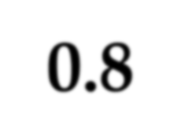

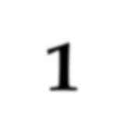
Heterogeneity?
Little / No heterogeneity
Notes:
one treatment effect
(largely) overlapping CIs
Consistent with one treatment effect, common to all studies

Slide 12
Heterogeneity?
Much heterogeneity

Slide 13
Quantifying heterogeneity with “Q”
Deviation from overall mean
Q is computed by summing the squared deviations of each study’s effect estimate from the overall effect estimate, weighting the contribution of each study by its weight Wi (its inverse variance, 1/SE²).

Slide 14
Quantifying heterogeneity with “Q”
Studies in the meta-analysis have limited sample size → there will always be random variation → Q is never zero!
Under the hypothesis of homogeneity (so: no heterogeneity) among the effect sizes, the Q statistic follows a chi-square distribution with k – 1 degrees of freedom, where k is the number of studies.
This means that with k studies, you expect Q to be approximately k-1

Slide 15
Other measures for heterogeneity: τ²
τ²: between study variance
Interpretation τ: standard deviation of the treatment effects, but adjusted for the imprecision that is always there when studies are limited in size
→ τ in same unit as meta-analysis outcome (e.g. mmol/L)
τ² = 0 if Q ≤ k-1 (no between-study heterogeneity)
τ² = (Q – (k-1) ) / C if Q > k-1 (constant C= Σ(W_{i})- Σ(W_{i}²) / Σ(W_{i}))
Σ = sum; W_{i}= 1/SE²; k=number of studies

Slide 16

Other measures for heterogeneity : I²
I² : proportion (%) of total variance explained by between-study heterogeneity
i.e. variability, not caused by chance but by clinical and/or statistical causes
σ²: within study variance (Standard Error SE² of “typical“ study)
Range I² : 0 – 100%
0: no between study heterogeneity
100%: very high level of between study heterogeneity

Slide 17
Rule of thumb for size of I²
As a rough guide, the I² statistic can be interpreted as follows:
0% to 40%: might not be important;
30% to 60%: moderate heterogeneity*
50% to 90%: substantial heterogeneity*
75% to 100%: considerable heterogeneity*.
Beware:
size and direction of effects
Sufficient number of studies needed for reliable estimate
Rule of thumb from Cochrane Handbook, open to debate

Slide 18
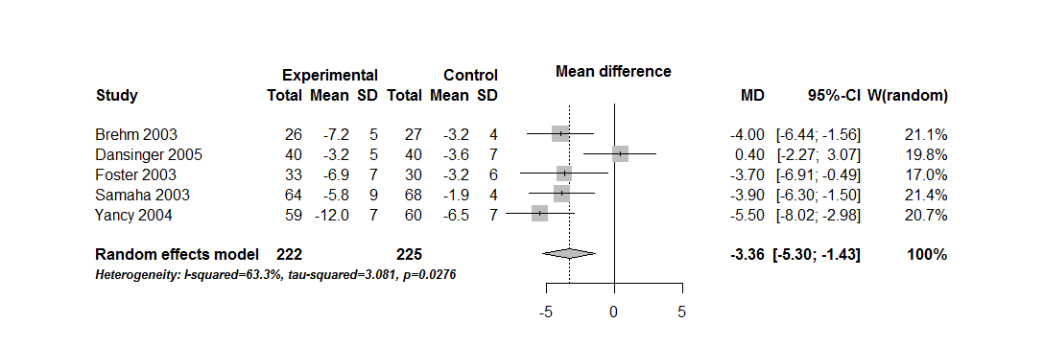

Effects of Low-Carbohydrate vs. Low-Fat Diets on Weight Loss (kg)
I² = 63.3%
τ² = 3.08 kg²
τ = √3.08 = 1.75 kg
τ plays a role in the calculation of the prediction interval, i.e. the range of the true differences between L-C and L-F diets
Notes:
Fluvio:\
Slide probably a bit complex. Please explain exactly the meaning of the the 95% confidence interval around the MD (precision around the mean effect size) in this random-effects model. Please use a more precise terminology introducing the concept of prediction interval, and then call it 95% ‘range of true differences’. Please explain that it is just an approximation of the PI, as you approximate the t value and the error factor (which should be the square root of (tau2 + variance of the mean effect)). That seems too technical but it is not, as we are in the context of samples, not the infinite population (good approx when there is a large number of studies) and it is important to send a clear messsage on how variance is partitioned.
Mention that the PI is not displayed on the forest plot

Slide 19

How to deal with heterogeneity?
Do not pool the data
SRs do not need to contain an MA
Account for it
Use an appropriate effect measure (e.g. SMD)
Use a random effects model
Explore it!
19

Slide 20
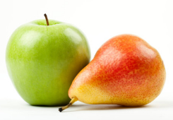
1. Do not pool at all
Systematic reviews need not contain any meta-analyses
Excessive clinical heterogeneity
→ don’t do a meta-analysis
But what if there is excessive statistical heterogeneity
among studies deemed a priori to be sufficiently
clinically homogenous?
There’s no right answer………
Notes:
In a systematic review, a decision about whether to pool the results of studies in meta-analysis needs to consider whether there are clinical or methodological differences between studies that might affect the results.
Participants, interventions, comparisons and outcomes need to be considered to determine whether they are sufficiently similar to ensure a clinically meaningful answer.
If studies are very dissimilar on some or all of these factors, it may be preferable not to pool the results.
If, on the other hand, a group of studies seem to be similar enough clinically and methodologically to pool in meta-analysis, then authors must consider statistical heterogeneity in the models.
Even though a review deliberately selects studies that may be similar in many ways based on these factors, there can still be substantial differences that mean it might not make sense to pool studies.

Slide 21

2. If you pool the data: use RE model
Analysis of single true effect:
fixed-effect analysis
Analysis assuming a
range of multiple true effects
(heterogeneity): random-effects analysis
Notes:
Account for the heterogeneity: use Random Effects Model instead of fixed effect model
It is critical to assess the presence and extent (degree) of between-study variation:
The heterogeneity can affect the conclusions from the meta-analysis
Any statistical heterogeneity that is detected in results must also be taken into account when interpreting the results, as this can affect the generalisability of the conclusions that can be drawn.

Slide 22
3. Explore heterogeneity: subgroup analysis
Table S3 | Subgroup analysis serum creatinine
Subgroup | n experiments | n studies | I² | n IRI only | n IRI + IPC | SMD and 95% confidence interval
overall | 62 | 33 | 83% | 512 | 492 | 1.54 [1.16, 1.93]
early | 47 | 25 | 81% | 413 | 384 | 1.10 [0.72, 1.48]
late | 15 | 9 | 80% | 99 | 108 | 3.53 [2.45, 4.60]
continuous | 32 | 18 | 80% | 257 | 250 | 1.77 [1.25, 2.29]
fractionated | 30 | 20 | 85% | 255 | 242 | 1.31 [0.74, 1.87]
LIPC | 51 | 29 | 83% | 421 | 390 | 1.47 [1.03, 1.90]
RIPC | 6 | 3 | 79% | 60 | 60 | 1.53 [0.57, 2.48]
LIPC + RIPC | 5 | 1 | 76% | 31 | 42 | 2.48 [1.09, 3.87]
male | 42 | 22 | 79% | 345 | 39 | 1.51 [1.09, 1.93]
female | 2 | 2 | 24% | 17 | 18 | -0.03 [-0.83, 0.76]
male + female | 11 | 4 | 82% | 87 | 81 | 1.13 [0.25, 2.02]
mouse | 22 | 12 | 84% | 173 | 170 | 2.72 [1.88, 3.55]
rat | 35 | 18 | 78% | 303 | 286 | 1.02 [0.61, 1.44]
IRI = ischemia-reperfusion injury, IPC = ischemic preconditioning, SMD = standardized mean difference, LIPC = local ischemic preconditioning, RIPC = remote ischemic preconditioning
22

Slide 23
Subgroup analyses
Are there differences in treatment effects between subgroups? i.e. is the treatment more effective in one subgroup than in the other subgroup?
Split the data in order to make comparisons between subgroups
Subsets of studies (e.g. participant type, study design)
Subsets of participants (e.g. low versus high educational level; younger versus older people)
Possibly individual participant data needed
Outside scope of this course
N.B. Not prespecified subgroup analyses are hypothesis generating

Slide 24
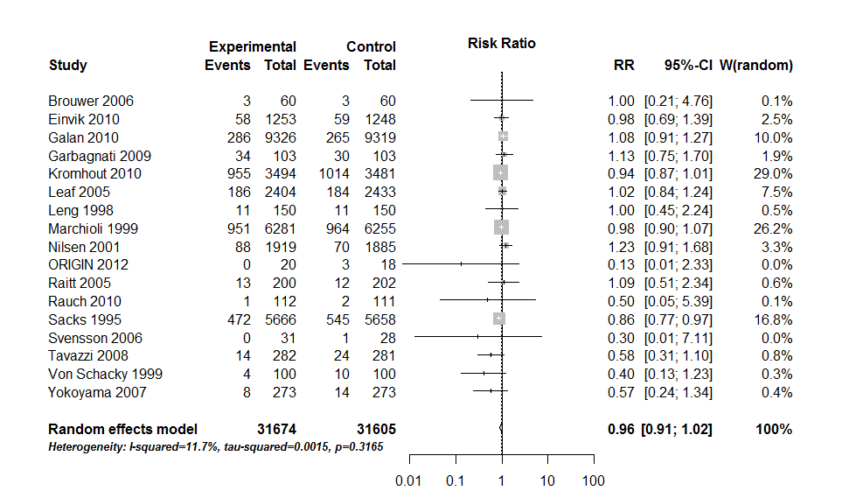
Omega-3 Supplements for prevention of All-Cause Mortality
Heterogeneity: I-squared = 11.7%
Notes:
# ICD indicates implantable cardioverter-defibrillator;
# PUFAs, polyunsaturated fatty acids
Ook al is de heterogeniteit hier niet zo groot, het is bekend dat in de praktijk deze studies plaats vinden in verschillende CVD prevention settings, nl. with patienten met implantable cardioverter defibrillator, in patients with secondary .
Association Between Omega-3 Fatty Acid Supplementation and Risk of Major
Cardiovascular Disease Events . A Systematic Review and Meta-analysis
Rizos et al, jama 2012

Slide 25
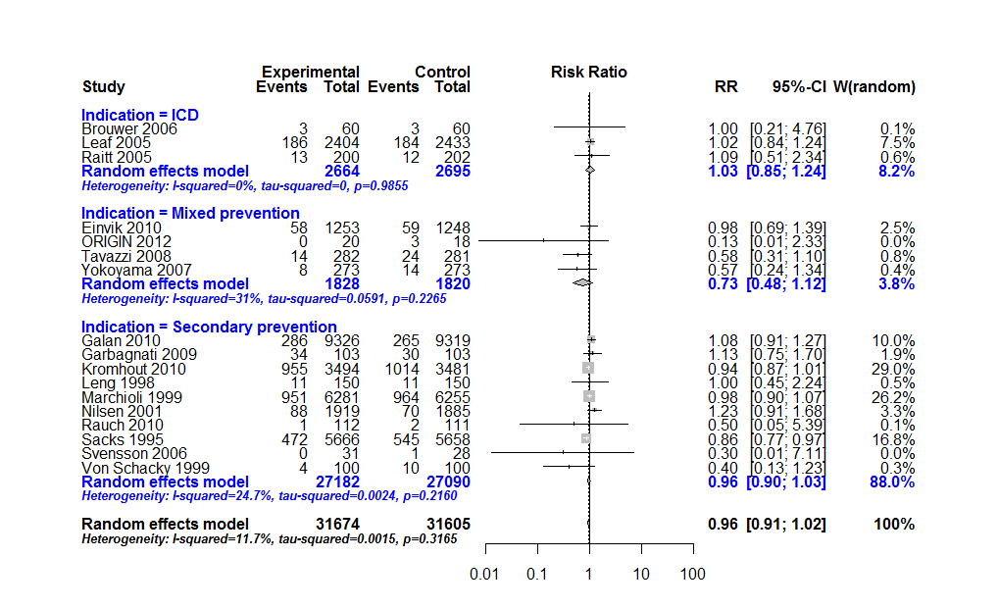
Subgroups by indication
Notes:
Test for subgroup differences (random effects model): Q d.f. p-value 2.05 2 0.3580

Slide 26
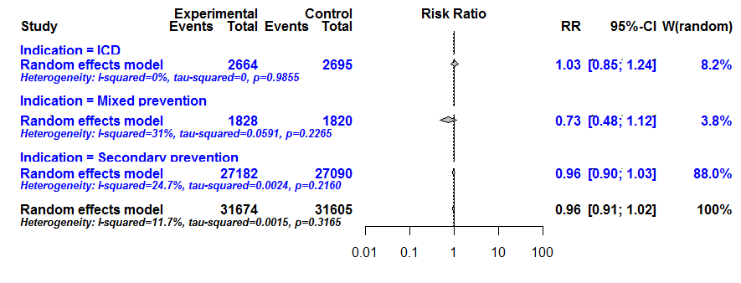
Omega-3 Supplements for prevention of All-Cause Mortality
No statistically significant difference between subgroups:
Test for subgroup differences (RE model): Q=2.05, df=2, p-value= 0.358
Notes:
Test for subgroup differences (random effects model): Q d.f. p-value 2.05 2 0.3580

Slide 27
Which subgroups to investigate?
Use Effect modifiers (i.e. factors that can affect how well the intervention works)
Features of the intervention (e.g. intensity, content, delivery)
Study methodology (study design, quality)
Study features (e.g. length of the study)
Not: Prognostic factors
unless they are capable of modifying the intervention’s effects
Pre-specify subgroup analyses in the protocol!

Slide 28
Interpreting subgroup analyses
Comparisons between subgroups are based on not-randomised comparisons
Potential bias!
As the number of subgroup analyses increases, the rate of false findings also grows
Consider whether potential factors for investigation might be confounded
if two factors co-occur and cannot be disentangled from the effects of others
for example: more intensive follow-up in older patients

Slide 29
Subgroup Credibility Criteria
Is the subgroup variable measured at baseline or later?
post-randomisation: characteristic may arise due to the effects of the intervention itself
Was the subgroup pre-specified (a priori)?
Was the direction of the effect pre-specified?
Is the size of the subgroup effect large?
Is the interaction consistent across closely related outcomes?
Oxman (2012). Subgroup analyses: The devil is in the interpretation. BMJ.
Sun et al (2010). Is a subgroup effect believable? Updating criteria to evaluate the credibility of subgroup analyses. BMJ.
Notes:
In plain language, these criteria can be used to assign an overall assessment of the confidence that can
be placed in subgroup analyses. These judgements range from an assessment of ‘very low confidence’
to high confidence’ depending on whether key criteria are met or not met – see Oxman 2012 for a full
description of this.

Slide 30
Interpreting subgroup analyses (2)
Post hoc subgroup analyses can be misleading
Data driven? (by knowledge of the studies’ results)
Use caution in all cases!
See Cochrane Handbook 9.6.3, 9.6.3.1 and 9.6.6 for common errors in interpreting the results of subgroup analyses and suggestions on interpretation of results
Advice :
Keep number of subgroups to a minimum
Each subgroup must be pre-specified with a clear rationale
Sufficient number of studies needed
Alternative: narrative exploration of heterogeneity

Slide 31
Exploring heterogeneity: Statistical heterogeneity measures (group assignment) (Day 2 – Part 5)
Joanna in ‘t Hout

Slide 32
Exploring heterogeneity: Interpretation incl. subgroup analysis (Day 2 – Part 6)
Joanna in ‘t Hout

